Slide 1
Electromagnetic Calorimeter Development at NCCU
Caesar R. Jackson, Ph.D.
Benjamin Crowe, Ph.D.
Tanina Bradley, Ph.D.
North Carolina Central University (NCCU)
SuperBigBite Collaboration Meeting
Jefferson Laboratory
July 22, 2016

Slide 2
Organization of Presentation
About NCCU
About the NCCU Detector Development Group
NCCU Electromagnetic Calorimeter Development Plans
NCCU Resources

Slide 3
About NCCU
North Carolina Central University (NCCU), located in Durham, NC within the world renowned Research Triangle Park, is one of the 17 constituent institutions in the University of North Carolina (UNC) System and the first public university for African Americans in the country.
NCCU has STEM baccalaureate and master’s degree programs in Biology; Chemistry; Environmental, Earth & Geospatial Sciences; Mathematics; Physics; and Pharmaceutical Science.
UG STEM Enrollment over 700
GD STEM enrollment ≈ 70
UG STEM Degrees awarded ≈ 100
GD STEM Degrees awarded ≈ 35
The ethnicities of the STEM student body are approximately 83% African American; 5% White; 2.5% Asian; 2% Hispanic; Females are 63% and males are 37% of the STEM undergraduate student body.

Slide 4
About the NCCU Detector Development Group
Consist of three PhD faculty members in the Department of Mathematics & Physics, College of Arts & Sciences at NCCU:
Caesar Jackson, professor; Physics (Nuclear), NC State
Benjamin Crowe, associate professor; Physics (Nuclear), Purdue Univ
Tanina Bradley, research scientist, Electrical Engineering, NC A&T SU
Collective experiences:
Low & high energy experimental nuclear physics
Accelerator physics (Tandem Van de Graaff; electron storage ring; high intensity gamma-ray source; CEBAF)
Power systems (high voltage; high current; highly regulated; switching;…)
Thin film semiconductor development
Flexible displays development

Slide 5
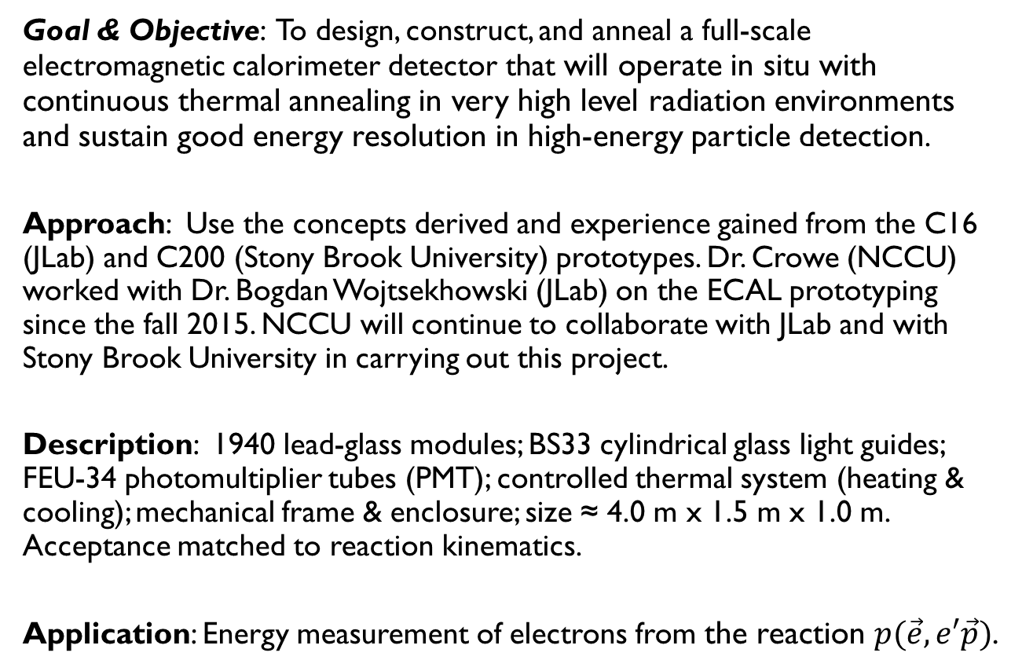
NCCU Electromagnetic Calorimeter Development Plans
Goal & Objective: To design, construct, and anneal a full-scale electromagnetic calorimeter detector that will operate in situ with continuous thermal annealing in very high level radiation environments and sustain good energy resolution in high-energy particle detection.
Approach: Use the concepts derived and experience gained from the C16 (JLab) and C200 (Stony Brook University) prototypes. Dr. Crowe (NCCU) worked with Dr. Bogdan Wojtsekhowski (JLab) on the ECAL prototyping since the fall 2015. NCCU will continue to collaborate with JLab and with Stony Brook University in carrying out this project.
Description: 1940 lead-glass modules; BS33 cylindrical glass light guides; FEU-34 photomultiplier tubes (PMT); controlled thermal system (heating & cooling); mechanical frame & enclosure; size ≈ 4.0 m x 1.5 m x 1.0 m. Acceptance matched to reaction kinematics.
Application: Energy measurement of electrons from the reaction $p(\vec{e},e′\vec{p})$.

Slide 6
NCCU Electromagnetic Calorimeter Development Plans (con’t)
Timelines:
Summer 2016 | NSF proposal submitted; Budget Request: calorimeter components materials & supplies; faculty travel and summer support
Fall 2016 | Part and materials procurement Prepare mechanical design drawings Design thermal system
Winter 2016-2017 | Assemble of modules (lead glass, light glass, PMT, etc.) Procure mechanical frames (super module, main frame, etc.)
Spring 2017 | Detector assembly and testing
Summer 2017 | Disassembly and shipping to Jlab Reassembly JLab
Long-Term | Participate in other experimental programs at JLab

Slide 7
NCCU Resources
Funding Plans: Supplemental proposal submitted to NSF; $200k requested (one-year); Currently under consideration for funding.
Personnel: Three NCCU faculty members as previously defined; Will seek funding to hire master’s students and undergraduate students.
Other Resources: Lab space an utilities to build, assemble and test; Nearby Duke-TUNL machine shop for hire;

